Slide 1
Jupyter Notebook Overview

Slide 2
Jupyter Notebook
Jupyter Notebooks enable to create documents mixing rich text with live code and data visualizations.
It is a great tool to share your data analysis with others, collaborate, teach, and promote reproducible science.
It currently supports around 40 programming languages, including Python, R and Julia (Ju-pyt-R).

Slide 3
How to install Jupyter Notebook
Anaconda
For new users, the general consensus is that you should use the Anaconda distribution to install both Python and the Jupyter notebook.
Anaconda installs both these tools and includes quite a lot of packages commonly used in the data science and machine learning community. You can download the latest version of Anaconda from:
https://jupyter.readthedocs.io/en/latest/install.html

Slide 4
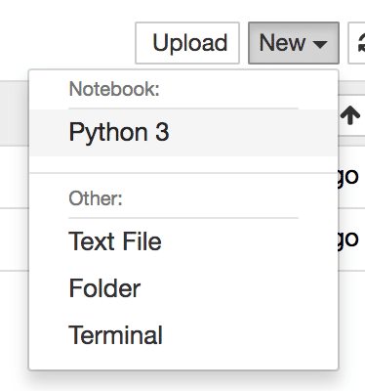
Creating A New Notebook
Creating a new Jupyter Notebook is easy. Just use the New dropdown menu and you’ll see the following options:
Select option Python 3 to open a new
Jupyter Notebook for Python.
The notebook is created

Slide 5
Exporting The Notebook
Jupyter Notebook gives you several options to export your notebook.
Those options can be found in menu File → Download as

Slide 6
How the notebook is stored
The notebook file is stored in a format called JSON and has the suffix .ipynb.
Just like HTML for a webpage, what’s saved in a notebook file looks different from what you see in your browser.

Slide 7
How to evaluate a cell
Evaluate the current cell and move to next cell: Shift + Enter
Evaluate the current cell and keep on current cell: CTRL + Enter
Evaluate the current cell and add a new empty cell below: Alt + Enter

Slide 8
Getting help
Open function search: Ctrl + Shift + P
Get the help for a function: Shift + Tab with the cursor inside the function

Slide 9
Keyboard shortcuts
While in command mode
A to insert a new cell above the current cell
B to insert a new cell below.
M to change the current cell to Markdown
Y to change it back to code
D D (press the key twice) to delete the current cell

Slide 10
Keyboard shortcuts
While in edit mode
Ctrl + Shift + - will split the current cell into two from where your cursor is
Esc + F Find and replace on your code but not the outputs
Esc + O Toggle cell output
Shift + J or Shift + Down select the next cells in a downwards direction
Shift + K or Shift + Up select cells in an upwards direction
Once cells are selected, you can then delete / copy / cut / paste / run them as a batch. This is helpful when you need to move parts of a notebook
Shift + M merge multiple cells

Slide 11
Thanks

